Slide 1

Human Resources
Presented by Karen Zandstra

Slide 2
What are the factors that influence employees to stay onboard?
Is it possible to predict if employees will stay and what could influence them to leave?

Slide 3

1 csv file
1470 rows
35 columns
The data

Slide 4

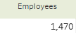
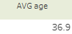
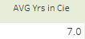
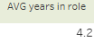
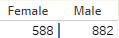
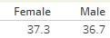
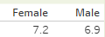
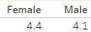
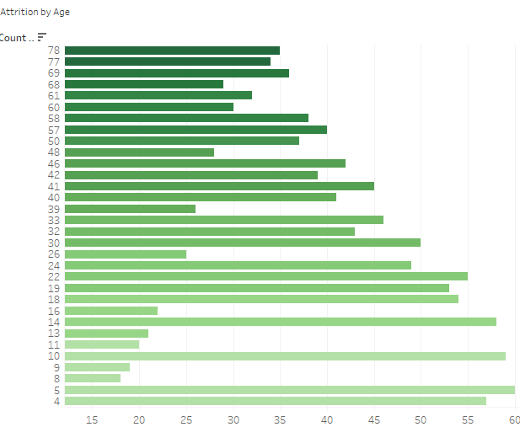
First Observations

Slide 5
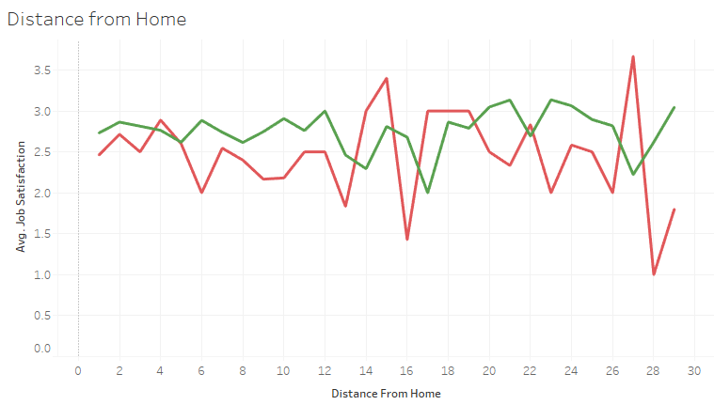
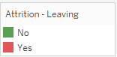
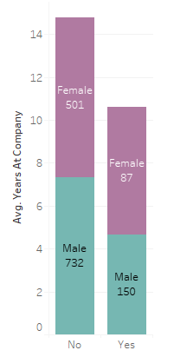
Exploring behaviour with Distance & Gender
CONSEIL 1

Slide 6

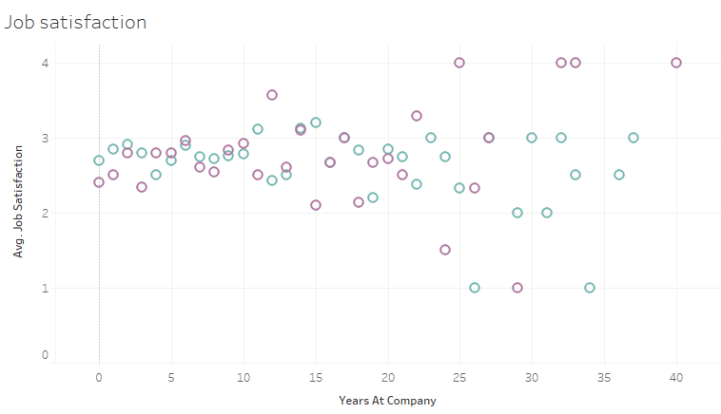
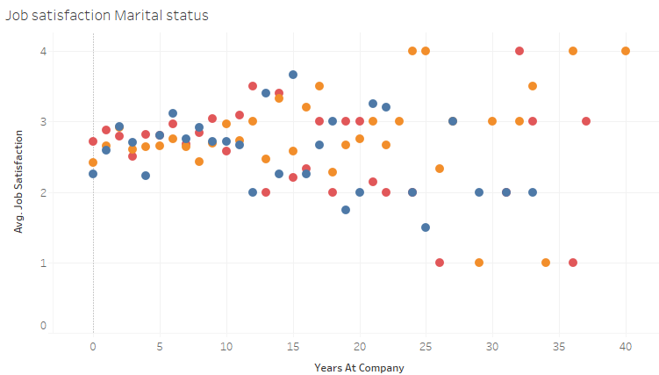
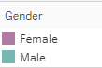
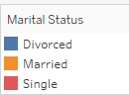
Job Satisfaction
between sexes and Marital Status

Slide 7

Machine Learning

Slide 8

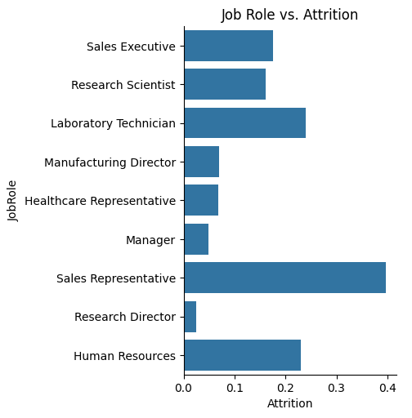
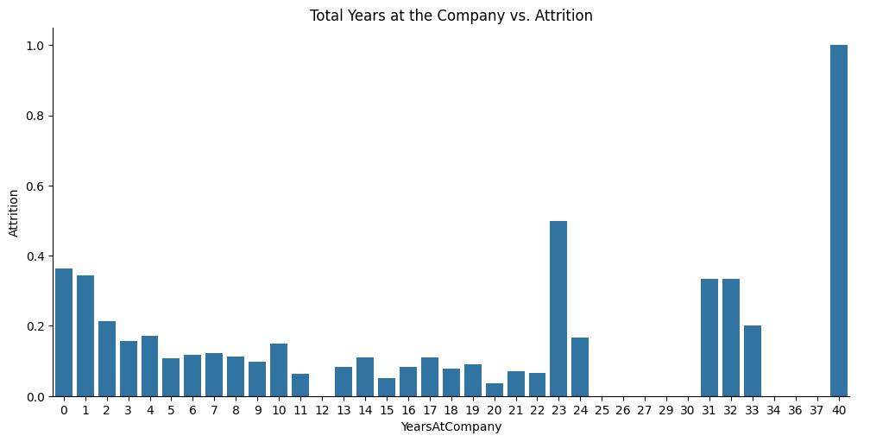
Correct columns:
‘Attrition’ & ‘Overtime’
with Yes and No values to 1 and 0
Drop column ‘Over18’
Data Target & cleaning
Attrition
0 (No) 1233
1 (Yes) 237
19 % rate of Attrition

Slide 9
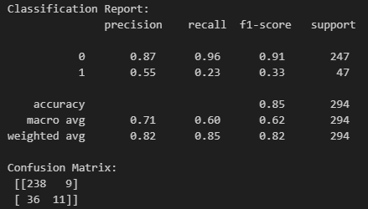
Random Forest
Identify X and y
Split train and test set
Apply SMOTE to resample X_train, y_train
Random Forest with GridSearchCV to select best combination of hyperparameters

Slide 10
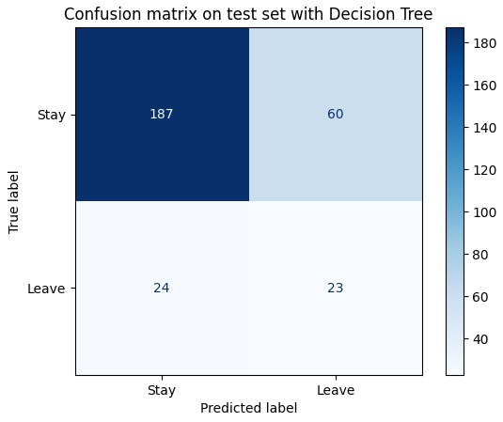
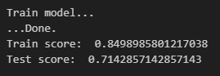
Decision Tree

Slide 11
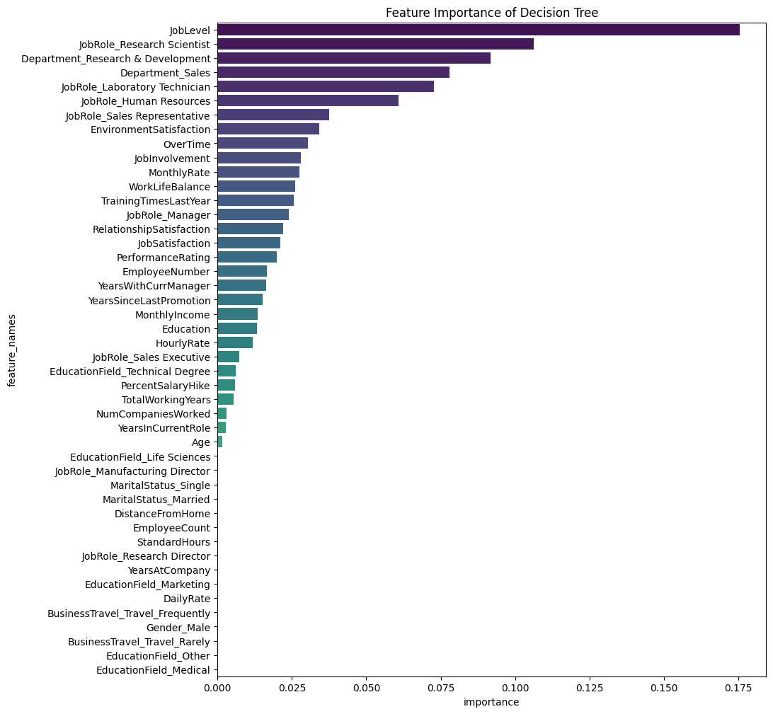
Feature Importance
TOP 6
Job Level
Role Research & Dev
Dep Research & development
Dep Sales
Role Laboratory Tech
Role Human resources
Surprise :
Monthly income is of very low importance

Slide 12

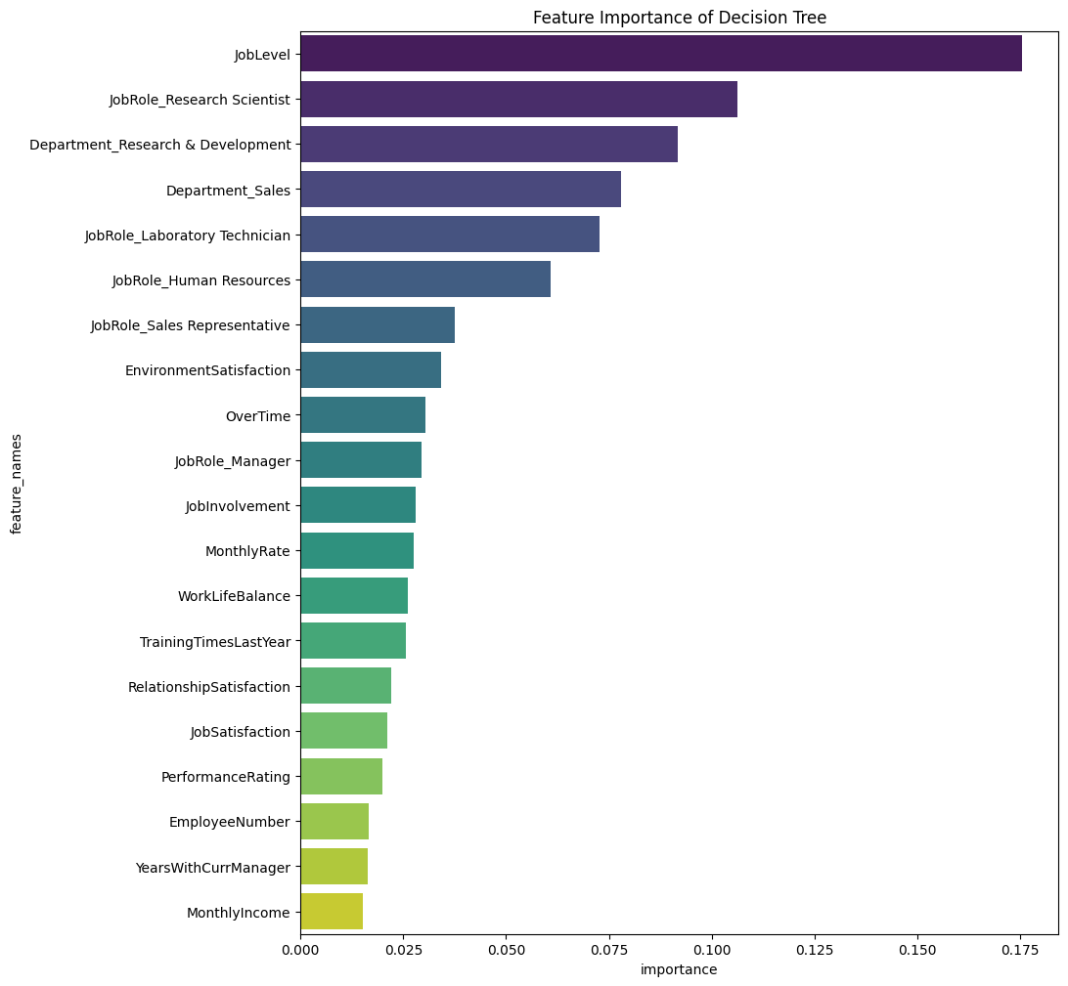
Conclusion plausible :
Le choix de rester en poste repose sur le type de rôle occupé par le salarié.

Slide 13

Questions ?

